Slide 1
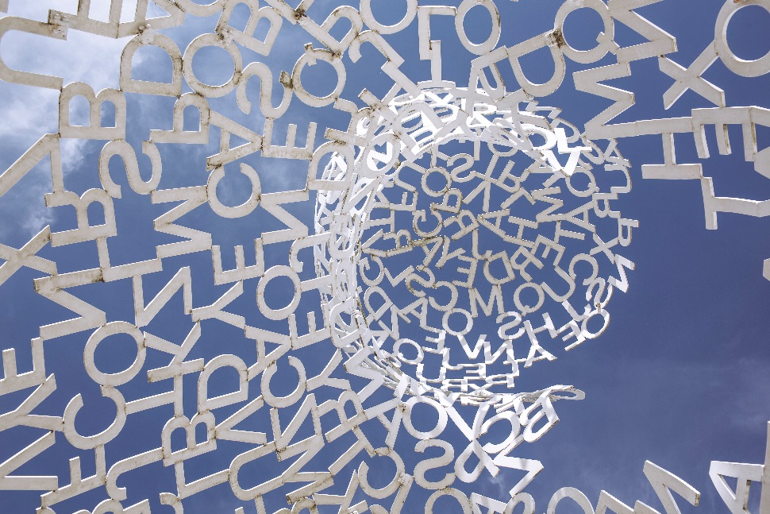
Dimensions of writing, types of writers and the writing process
https://cdn.gratisography.com/photos/419H.jpg
Writing Centre of the Department of Linguistics, 9 March 2020

Slide 2
Introduction
Who am I and what am I writing?
  name
  degree programme
  semester
  native language(s)
  number of term or other papers already written
  current writing project
  expectations of the seminar

Slide 3
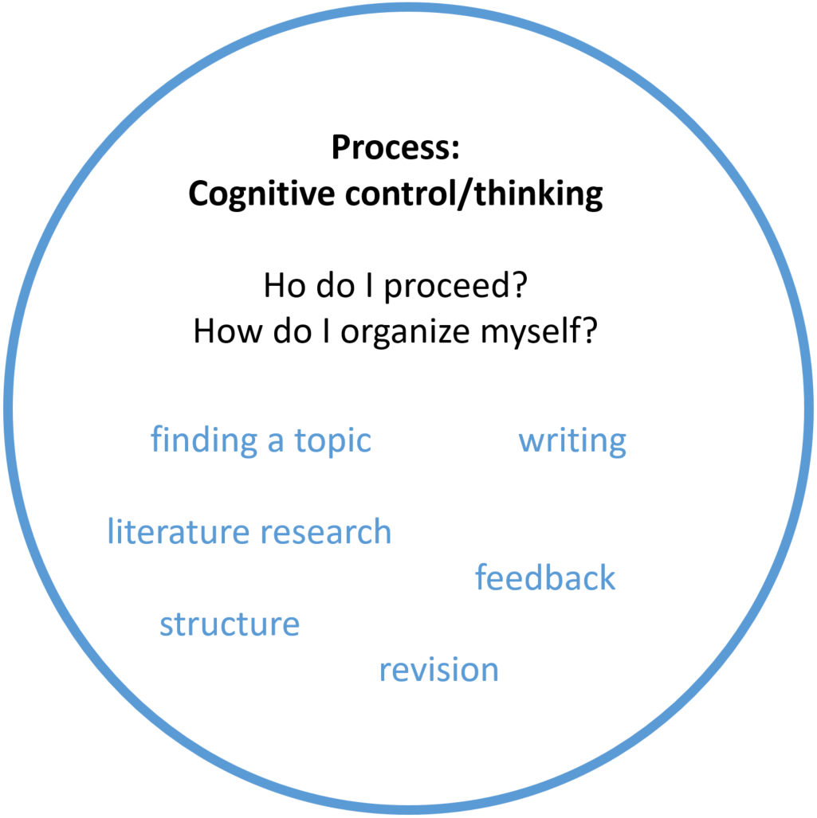
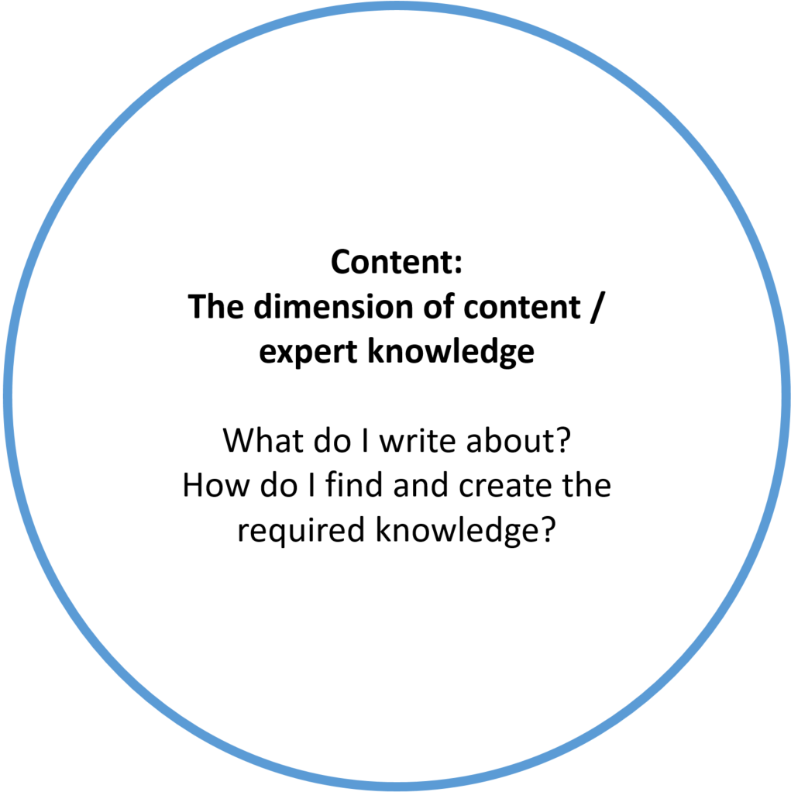
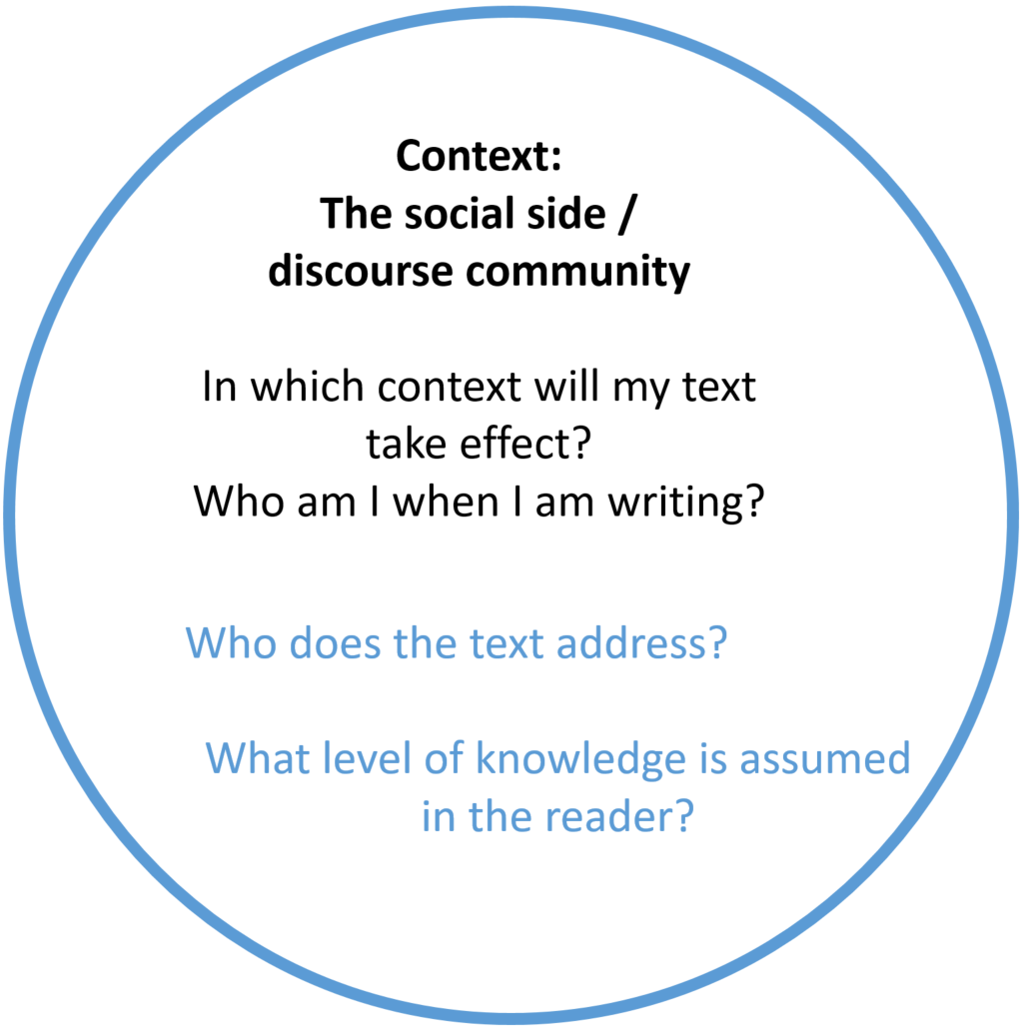
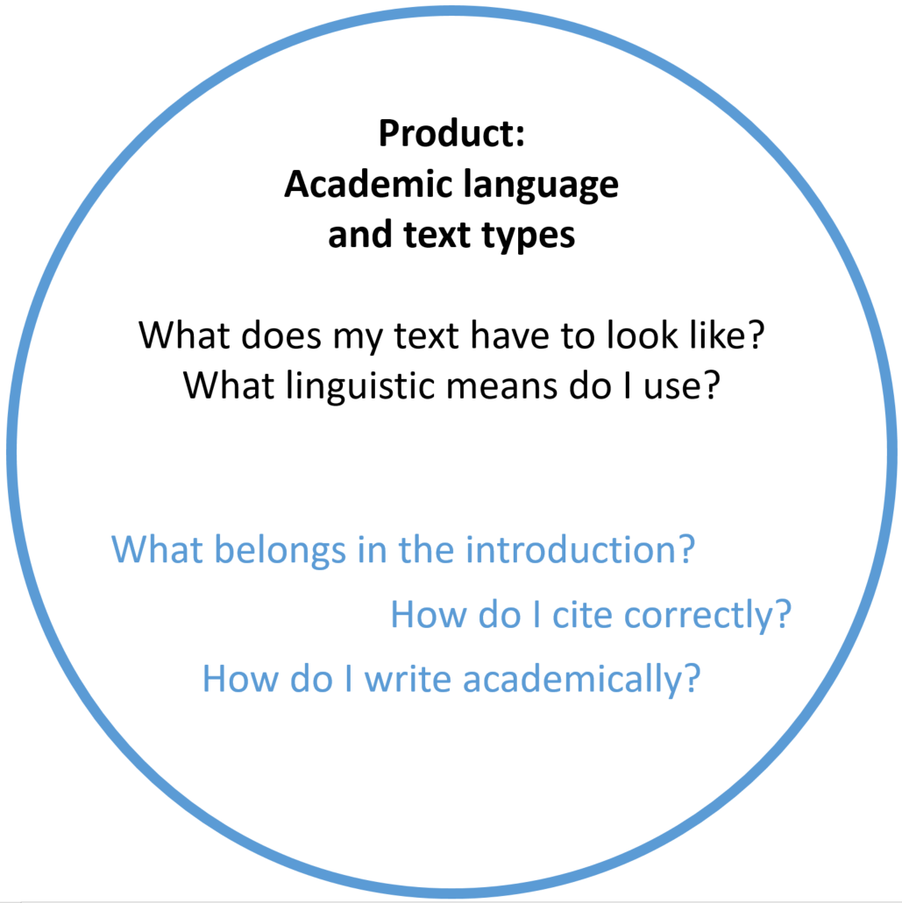
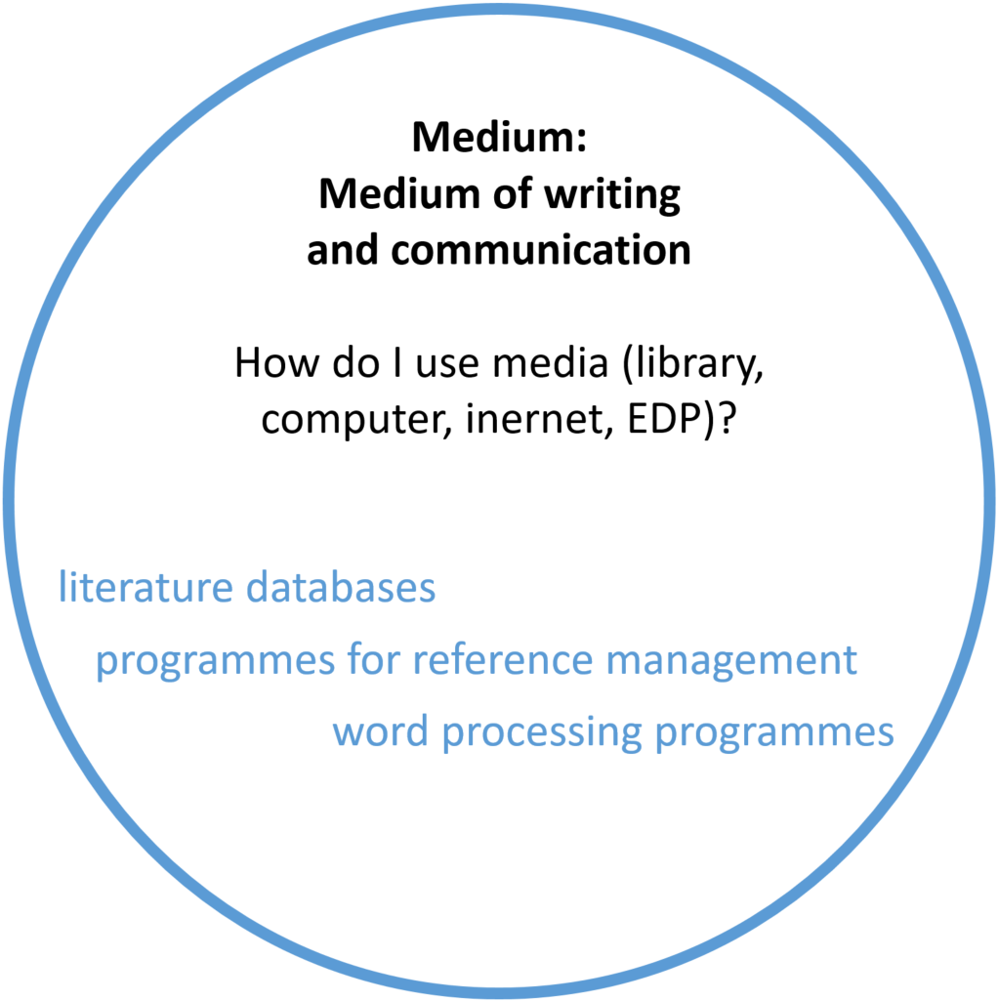
Dimensions
of academic writing
Kruse, Otto. 2012. Wissenschaftliches Schreiben und studentisches Lernen. Hochschuldidaktik Universität Zürich Dossier.

Slide 9
Dimensions
of academic writing
Kruse, Otto. 2012. Wissenschaftliches Schreiben und studentisches Lernen. Hochschuldidaktik Universität Zürich Dossier.

Slide 10
Everyone writes differently
What type of writer am I?*
  Task
  Carry out the test in individually.
  Evaluate the test. How often did you answer (a), (b), (c) or (d)?
*Test and evaluation adapted by Melanie Seiß from:
Arnold, Sven, Rosaria Chirico & Daniela Liebscher. 2012. Goldgräber oder Eichhörnchen - welcher Schreibertyp sind Sie? Über 350 Interessierte entdeckten ihren Schreibertyp und nutzten die "Speed-Beratung" bei der Langen Nacht der Wissenschaften 2011 in Berlin. Journal der Schreibberatung 4. 82–97.

Slide 11
Everyone writes differently
Group work
  Task
  Describe your approach to writing.
  What are the benefits and risks?
  Find a suitable label or motto.

Slide 12
Everyone writes differently
Mostly (a): The write away writers
  Motto: The journey is the destination.
  You like to write away and you only develop your ideas and the structure of your texts while writing.
Advantages
  You write freely and carefree and it rarely gets boring.
  You are open to new ideas, which you often find when writing.
  You can soon see what you have achieved.
Risks
  You easily drift away from the actual topic.
  You need to allow more time for revision.
  There is no end in sight.

Slide 13
Everyone writes differently
Mostly (a): The write away writer
  Motto: The journey is the destination.
  You like to write away and you only develop your ideas and the structure of your texts while writing.
Writing adventurers
e.g. André Breton, Martin Walser (Death of a Critic), Siegfried Lenz

Slide 14
Everyone writes differently
Mostly (b): The patchwork writer
  Motto: Gather and leap.
  You do not write from beginning to end, but at this or that part of the text. In between, you also interrupt writing to research information.
Advantages
  You are flexible and can continue writing in another section if you are not making progress.
  Many small tasks reduce your fear of the big picture.
  Preliminarity prevents paralyzing perfectionism.
Risks
  You may put difficult text parts off infinitely.
  You may lose track easily.
  There is no end in sight.

Slide 15
Everyone writes differently
Mostly (b): The patchwork writer
  Motto: Gather and leap.
  You do not write from beginning to end, but at this or that part of the text. In between, you also interrupt writing to research information.
Squirrels
e.g. Ingeborg Bachmann (poetry, Malina), Günther Grass (The Tin Drum, Cat and Mouse), Thomas Mann (Death in Venice, The Magic Mountain)

Slide 16
Everyone writes differently
Mostly (c): The planners
  Motto: Plan and dig deep.
  You prefer to make a plan before you start and stick to it while writing.
Advantages
  Your approach is clear and allows for good time management.
  You can find the golden thread in your text at any time.
  You can explain your planning well to others and can write in a team.
Risks
  You are not open to new ideas.
  You may get lost in planning and start writing too late.
  It takes a long time before you see tangible results in the form of text.

Slide 17
Everyone writes differently
Mostly (c): The planners
  Motto: Plan and dig deep.
  You prefer to make a plan before you start and stick to it while writing.
Gold miners
e.g. Peter Handke, Hermann Hesse (Steppenwolf), Henning Mankell (Wallander crime series), Carl Zuckmayer

Slide 18
Everyone writes differently
Mostly (d): The writers of many versions
  Motto: Take several run-ups to get to the point.
  You write your texts in several versions: You often set aside the beginnings and parts of your text and then rewrite them.
Advantages
  You can write with no worries and without aspiring to perfection.
  You use writing to think.
  In the final version of your texts, you get to the point quickly.
Risks
  You have to part with a lot of text later.
  Writing seems time-consuming.
  You may lose track if too many versions are created.

Slide 19
Everyone writes differently
Mostly (d): The writers of many versions
  Motto: Take several run-ups to get to the point.
  You write your texts in several versions: You often set aside the beginnings and parts of your text and then rewrite them.
Decathletes
e.g. Friedrich Dürrenmatt (The Physicists, The Visit), Heinrich Böll (The Lost Honour of Katharina Blum, The Clown)

Slide 20
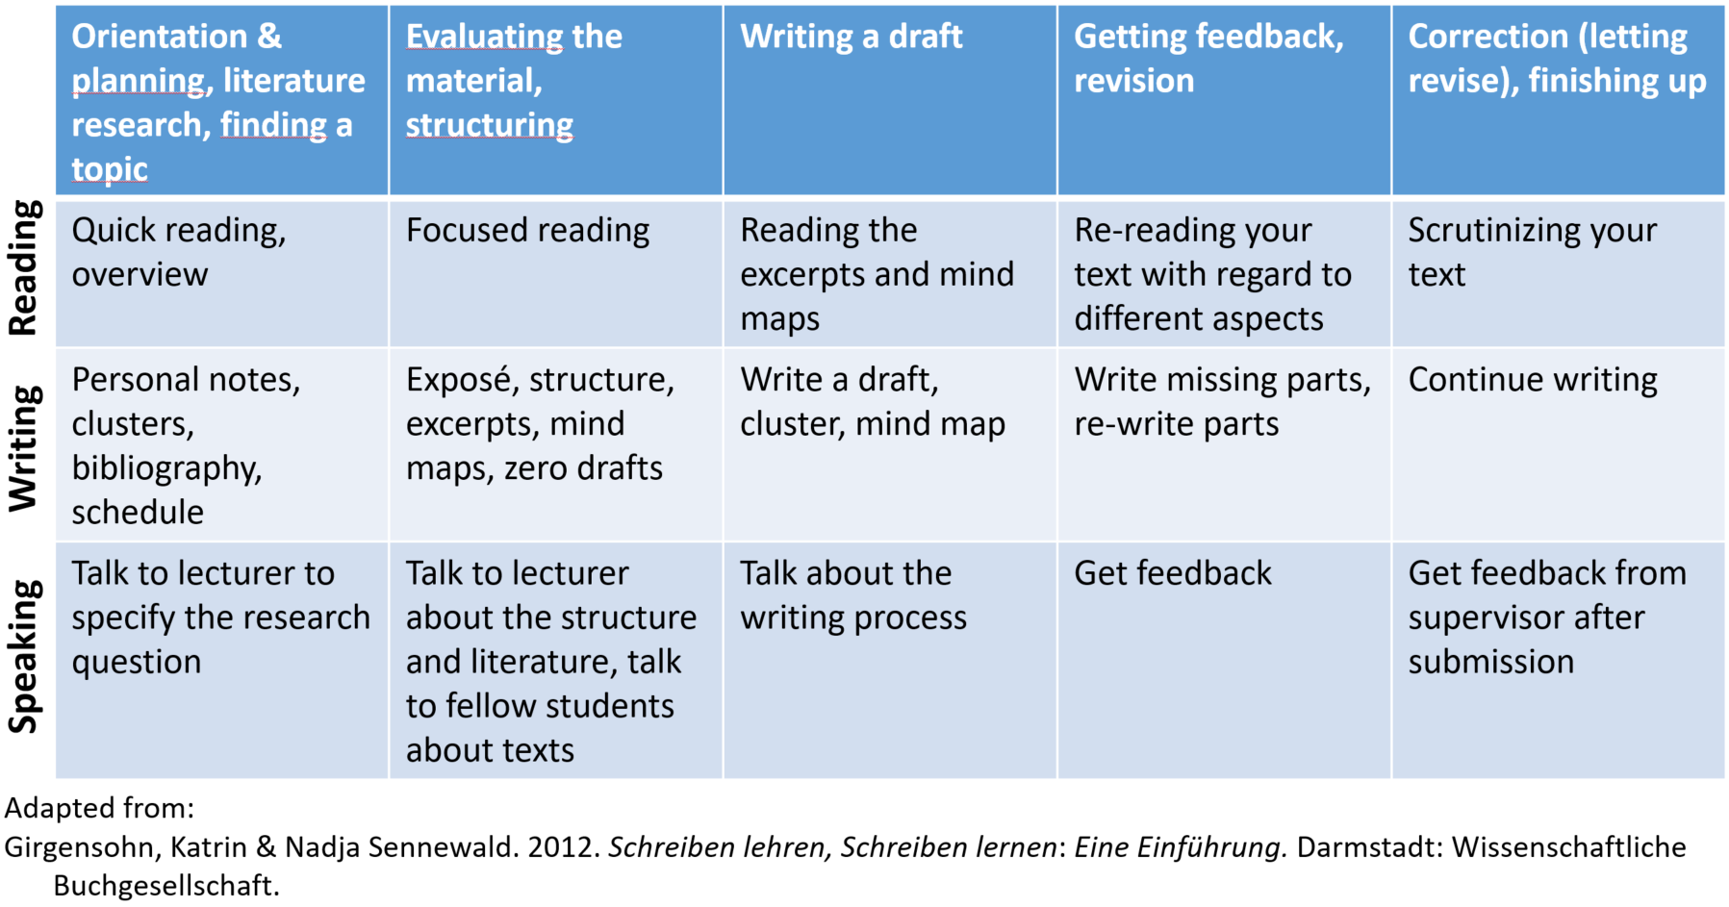
Model writing process

Slide 21
