Slide 1
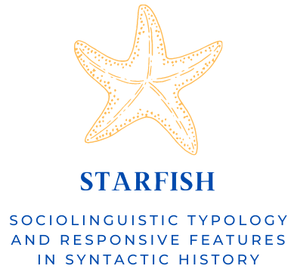
Sociolinguistic typology
meets historical
corpus linguistics
George Walkden, Gemma McCarley, Raquel Montero, Molly Rolf, Sarah Einhaus & Henri Kauhanen
Typology of Contact-Induced Changes in Morphosyntax
ICHL, Oxford, August 2022

Slide 2
This talk
From the workshop call:
Do insights from recent scholarship allow us to revisit and improve on the explanation and analysis of established cases of (possible) language contact?
This talk sketches a programme for doing exactly this in morphosyntax.
Trudgill (2011): different types of contact situation > different types of change.
Adult L2+ language acquisition leads to simplification.
Child bilingualism leads to complexification.
Our talk: do we find evidence for the first of these in the domain of (morpho)syntax? And how can this be investigated using historical corpora?

Slide 3
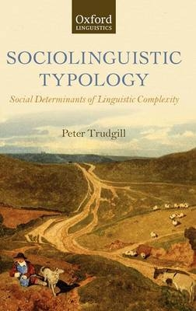
Trudgill (2011): sociolinguistic typology
Simplification occurs when a society contains a high proportion of post-critical-period acquirers – “a result of the lousy language-learning abilities of the human adult”.
Case study: Nubi verbal inflections.
Focus is on morphology and (in chapter 5) phonology.
What does complexity mean in syntax?
Methodology is based on “before/after”-style grammar comparison.
Quantitative analyses and fine-grained investigations of historical corpora (e.g. including geographical predictors) have the potential to shed more light on these questions.

Slide 4
Walkden & Breitbarth (2019): uninterpretable features
Following Trudgill, Walkden & Breitbarth (2019) equate complexity with L2-difficulty.
Interpretability Hypothesis (e.g. Tsimpli & Dimitrakopoulou 2007): uninterpretable features are not accessible to adult L2+ learners as part of the initial state.
In Minimalist syntactic theory, uninterpretable features:
are present only within the syntax
have no interpretation at the interfaces (i.e. no semantic content)
All else being equal, we predict that in sociohistorical situations in which adult L2 learners are dominant, uninterpretable features will typically be lost.
Need to distinguish L1 transfer and L1-relative difficulty

Slide 5
Complementary methods
To date, most of the empirical work on the Trudgill conjecture has relied on either:
large-scale typological-correlational studies (e.g. Sinnemäki 2020)
small-scale experiments in the lab (e.g. Berdicevskis & Semenuks 2022)
Typological studies are often based on (partially) flawed datasets; controlling for all relevant factors is difficult.
Experimental studies may lack ecological validity.
We take the view that a third method – historical corpus linguistics – can help to round out the picture.
Only the corpus-based approach can tell us whether the predictions are met on the ground, in real historical time, in concrete linguistic communities.

Slide 6
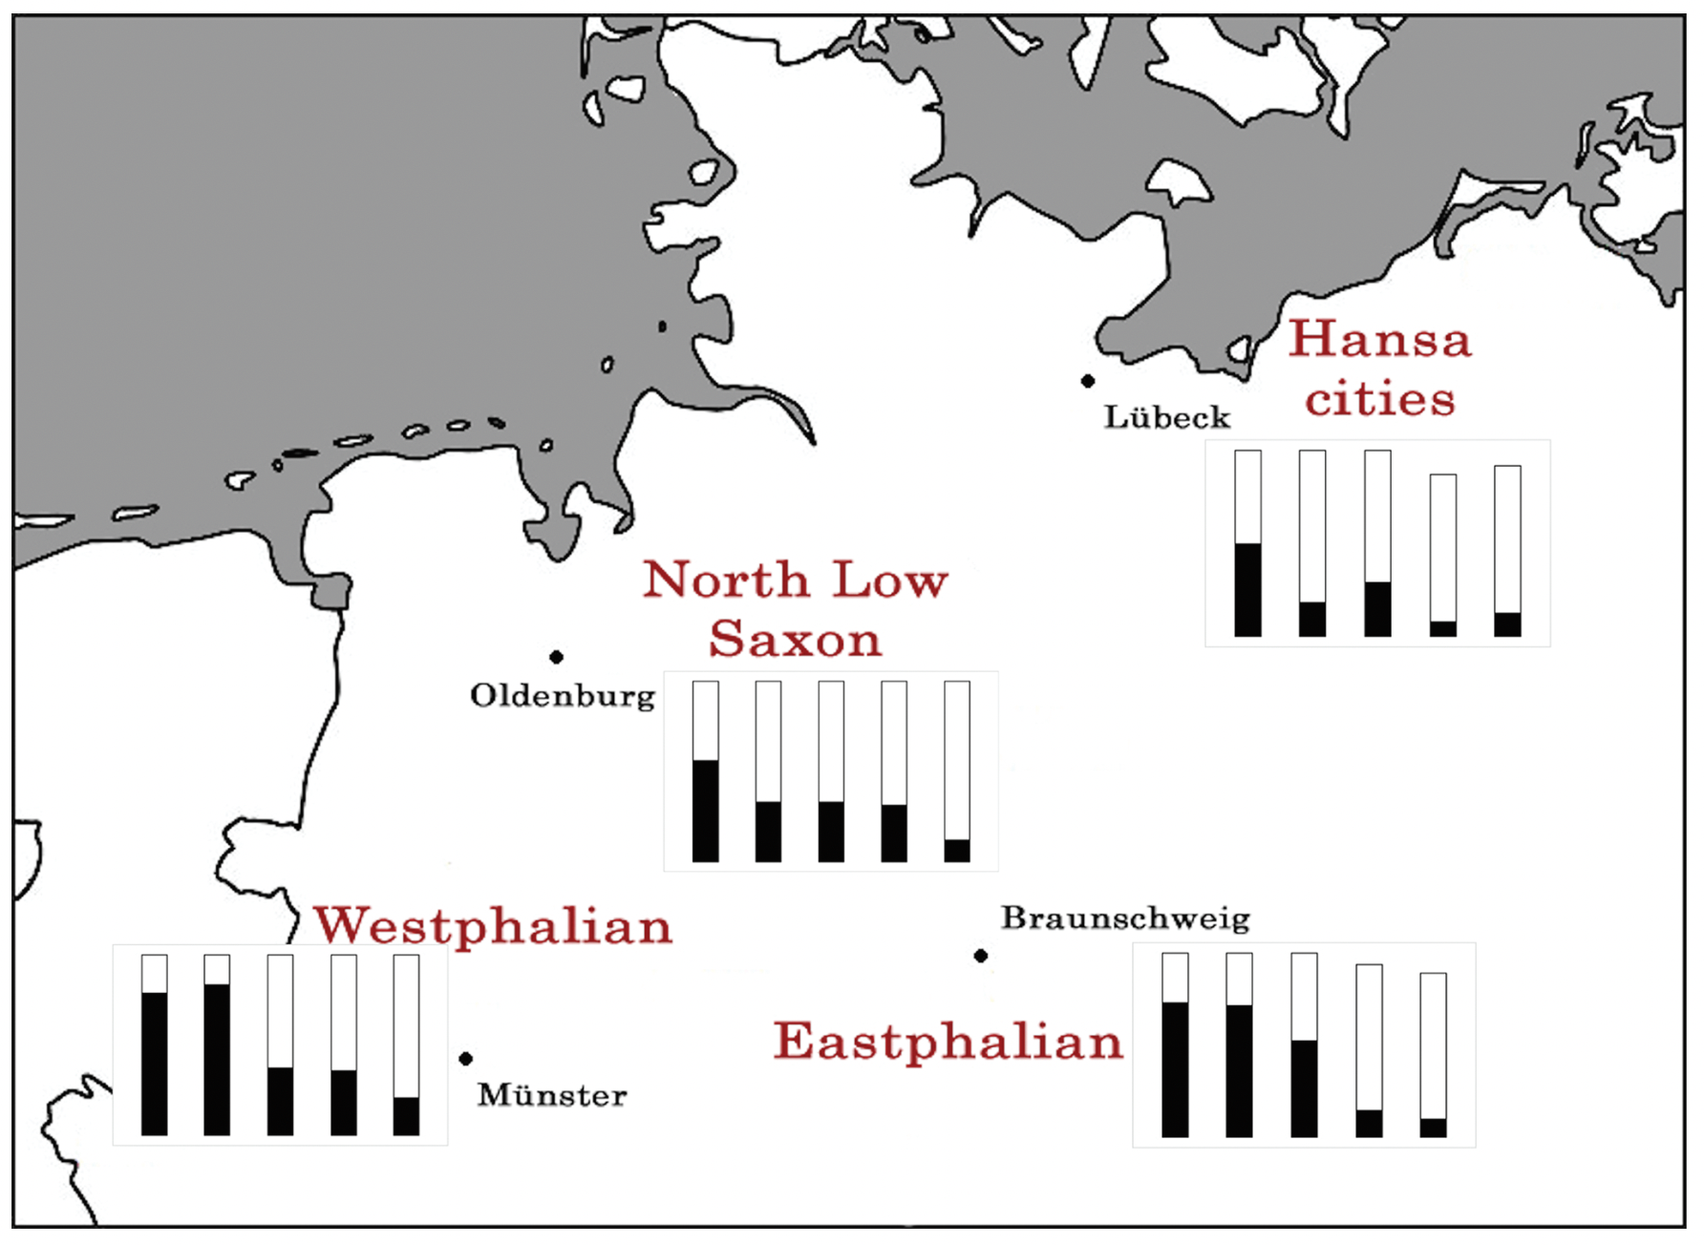
Example: negation in Middle Low German
Transition from Stage II to Stage III of Jespersen’s Cycle is simplification.
Stage I: en V
Stage II: en V … nicht
Stage III: V … nicht
In Stage II, en is an agreement marker bearing an uninterpretable feature.
﻿dar en sculle wii se nicht ane hinderen
there neg shall we them neg from bar
“we shall not bar them from it” (UB Lübeck 06/01/1450)
Hanseatic cities in the Neuland make the transition earliest and fastest (Breitbarth 2014).
﻿Use of Stage II en/ne … nicht (black) in the corpus of Breitbarth (2014)

Slide 7
Further predictions
Other areas in which predictions are made about morphosyntactic simplification:
Nominal agreement (e.g. for number)
Null subjects
Case

Slide 8
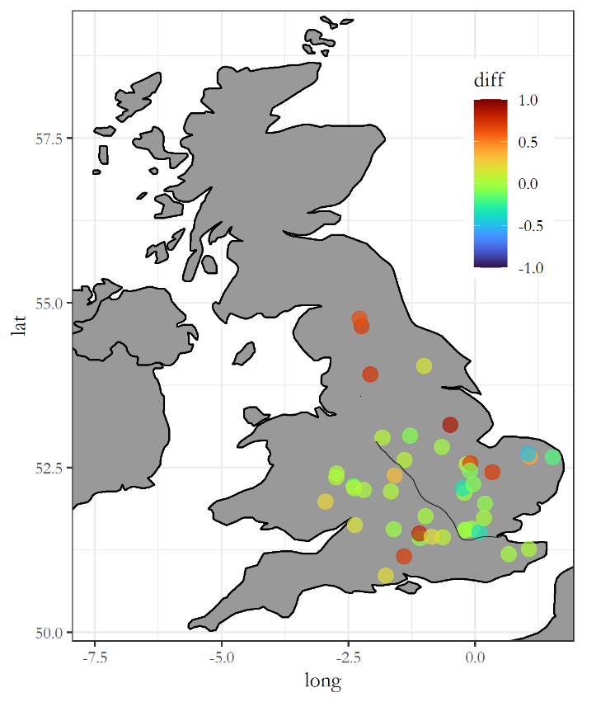
The loss of plural concord in Middle English
Plural Concord and the Scandinavian Contact
It has been argued that Scandinavian contact affected aspects of core syntax (e.g. V2 patterns, VO order, etc.)
We explored this effect on inflectional morphology, focusing on plural marking inside the DP, and found that:
The amount of concord between Q and Adj differs in some texts but not in others.
The North is the dialect with the highest density of texts showing this pattern.
We explore the different reasons why these patterns might have emerged in the North.
(For more, see the talk by Montero, Thur 11:30–12:00)
Difference in Plural Concord: Q vs Adj
Notes:
The first case study of morphosyntactic simplification potentially due to contact is the loss of plural concord in Middle English, where it is contact with Scandinavian causing the loss. This is based on previous suggestions of this contact affecting areas of the core syntax of English, such as V2 patterns and VO order.
If we postulate uninterpretable features within plural concord structures (following the idea that multiple plural number features with semantic content are not necessary), the idea is that a high proportion of Scandinavian L2 English speakers struggled to acquire these features and therefore plural concord, ultimately leading to the loss of plural concord in Middle English.
In particular, we have looked at plural marking concerning quantifiers and adjectives within the DP, using corpus data. The amount of concord between quantifiers and adjectives differs in some texts but not others, with the Northern dialect showing this pattern more, broadly speaking, as is seen by the darker red circles on the map.
The reasons behind the Northern dialect showing this pattern will be explored in the talk on this project by Raquel on Thursday; I won’t give any spoilers here.

Slide 9
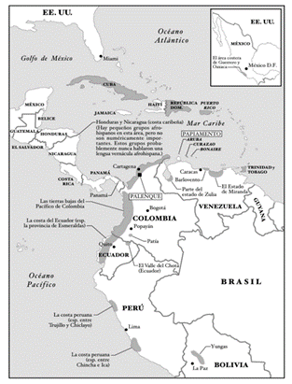
Null subjects in historical Latin American Spanish
Map: Afro-Hispanic areas of Latin America
Spanish is a null subject language.
However, Dominican Spanish has seen an increase in overt subject pronouns (and SV word order) (Toribio 2000).
Null subjects are also harder to acquire, particularly for L2 speakers (e.g. Bini 1993, Tsimpli & Lavidas 2019).
Afro-Hispanic Languages of the Americas (AHLAs) show many non-standard features such as increased overt subjects and SV order (Sessarego 2013).
The present study has constructed a corpus of 57 texts from eight countries over four centuries to evaluate the diachronic rate of null subjects and inversion in Latin American Spanish.
(Talk by McCarley, Mon 11:30–12:00)
Notes:
The second case study of potential contact-induced morphosyntactic simplification is null subjects in historical Latin American Spanish. Spanish is a consistent null subject language.
However, Dominican Spanish has seen an increase in overt subject pronouns (and SV word order)
In the literature, nullness has historically been linked with inversion in the literature e.g. in the null subject parameter, because most consistent null subject languages like Italian and Spanish also allow inversion
Null subjects are also harder to acquire, particularly for L2 speakers.
African slaves were brought over to the Americas by the Spanish from the 16th century onward.
Following Trudgill, this contact would be characterized as short-term adult second-language acquisition. As with the difficulty acquiring plural concord, we postulate that it is the uninterpretable features that cause the trouble for L2 speakers, leading in this case to the overproduction of overt subject pronouns.
Afro-Hispanic Languages of the Americas (AHLAs) show many non-standard features such as these increased overt subjects and SV order
The present study has constructed a corpus of 57 texts from eight countries over four centuries to evaluate the diachronic rate of null subjects and inversion in Latin American Spanish.
The aim is to determine whether the corpus supports the hypothesis that the rate of overt subject pronouns (as well as SV order) has risen significantly since contact with African L2-speakers.
Broadly, we expect to see in the corpus the highest variation in the form of more overt subject pronouns in varieties with the highest Afro-Hispanic populations. I cannot spoil the associated talk on this study because it took place yesterday, however Gemma is happy to discuss the talk further should you want to.

Slide 10
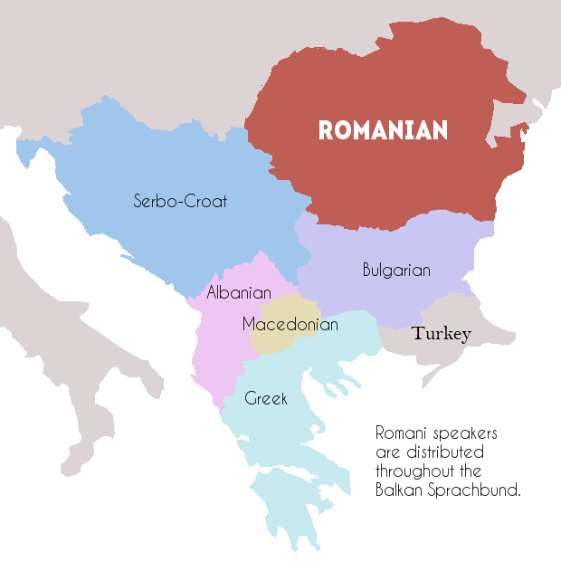
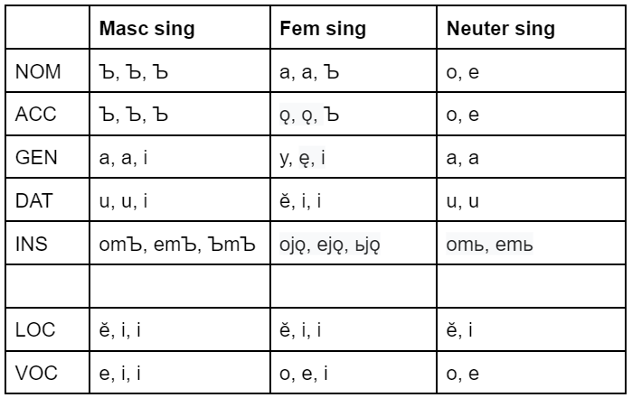
Case loss in Balkan Slavic
Variety of language families in the Balkan Sprachbund
Balkan Slavic almost completely lost case, the other languages also to varying extents, which can be explained by sociolinguistic factors
Map taken from
https://unravellingmag.com/fr/balkan-sprachbund-2/
Noun case endings in Old Church Slavonic, adapted from Gardiner (1984)
Notes:
Finally, we have the case study of case loss in Balkan Slavic, which I will spend a little more time discussing now.
Case in the Balkan Sprachbund as a whole seems to be a good case study for the type of contact-induced change we are looking at for a few reasons. Firstly, we see varying degrees of morphological case loss in the various members of the Sprachbund. Balkan Slavic has seen the most drastic m-case loss, with only some case distinctions seen today in the dialects and in the pronominal system, whereas Romani has retained a great deal of case. Why this may be has been explained sociolinguistically in the literature already, involving the factors of number of L2 speakers partially determined by prestige. The other reason the Sprachbund is of interest to our hypothesis is that there are multiple language families present in the Sprachbund (Turkish not even being Indo-European), indicating to me that under the right sociolinguistic conditions, case is an L2-difficult feature likely to be lost irrespective of the L1s involved. All the languages of the Sprachbund at one point had case systems. My work within the project then examines Case theoretically and examines whether corpus data backs up our hypothesis.

Slide 11
C/case XP
an approach in which m-case has its own XP in the syntax; it has syntactic reality, rather than only being assigned post-syntactically
Caha’s (2009) compositional, exploded KP accounts for patterns of case syncretism.
his proposal is that patterns of case syncretism and case inventories can be captured by Blake’s Case Hierarchy (1994): NOM, ACC, GEN, DAT, INS, COM.
The same syntactic structure can be applied to adpositions, e.g. English with.
‘I travelled with my friends.’ COM
‘I repaired the pot with some glue.’ INS
Notes:
There are, of course, many layers of C/case to tease apart, as well as many approaches to morphological case and syntactic case and how these interact with each other.
Some of these attribute uninterpretable features to case, some do not even postulate syntactic or abstract Case at all. These naturally therefore have different predictions for whether Case is a responsive feature, that is, a morphosyntactic feature that is L2-difficult and therefore likely to be lost. A big part of my project is exploring these intricacies of case.
One possible approach to the relationship between m-case and syntactic case is to give m-case its own syntactic reality. Caha’s exploded case-phrase depicts what this might look like, on the right of the slide, where we have a KP with several features, denoted by the numbers, with comitative case at the top containing all the other cases below it, instrumental containing all the cases below it, etc. This structure is based on Blake’s hierarchy, and aims to account for patterns of case syncretism and cross-linguistic case inventories. For instance, a language with the dative case must also have all the cases below it in the tree, and can only exhibit syncretism on cases adjacent on the tree, e.g. dative and genitive but not genitive and instrumental without also dative.
What I particularly like about the idea of this approach is the application of the same syntactic structure here to adpositions. E.g. in a language without case such as English, one could apply the same structure to the prepositions ‘to/for’ in the indirect object sense to the dative case marker syntactic structure. The approach extends to the ‘syncretism’ of adpositions, for example, English preposition ‘with’ can have both instrumental and comitative functions, and these are adjacent in the tree. This exploded case XP approach deals particularly well with the distribution and behaviour of the more functional cases (higher up the tree)- it is with this in mind that I examine the corpus data in the project.

Slide 12
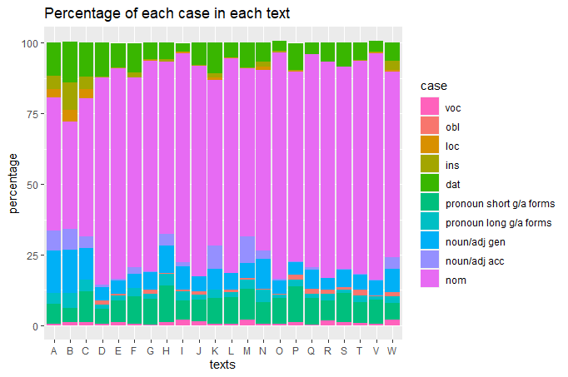
Case in the corpus (1)
Notes:
I will show now two graphs showing preliminary data from the corpus. The corpus I have used is the ‘Annotated Corpus of Pre-Standardised Balkan Slavic Literature’ corpus developed in the last few years in the University of Zurich. There are 23 prose texts ranging from the 15th to the 19th century. This first graph depicts the percentage of instances of each case-marked item (including nouns, adjectives and pronouns) in each text, with texts along the x-axis organised roughly from oldest to newest, each bar representing one text. As can be seen, there is no real clear pattern here concerning the presence of the non-nominative cases, other than the oldest three texts showing a more even spread of the cases. The issue here is that these three texts are Church Slavonic, considered by many to be a written standard and not representative of the spoken dialects.

Slide 13
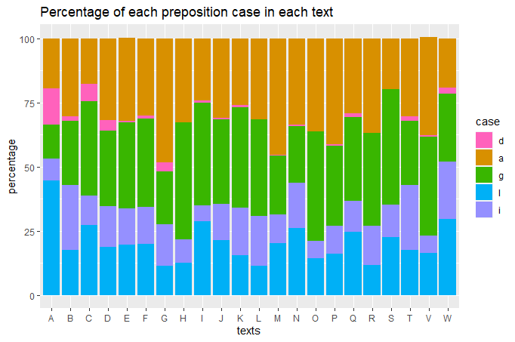
Case in the corpus (2)
Notes:
This second graph shows the preposition ‘case’ instances for the texts, with ‘d’ referring to dative-taking prepositions, ‘a’ accusative-taking prepositions and so forth. This is based on the morphological tagging in the corpus. What is clear to me is that a closer look into the relation between form and function of these prepositions is required in order to have a better understanding of their status in the corpus and how they relate to the case markers proper. It is in this direction, and in the sense of the parallel syntactic structures of case markers and prepositions, that this project will move now- and not only due to the lack of older Bulgarian sources which would show the loss of m-case we cannot see in these graphs.

Slide 14
Summary of case studies
All else being equal, we predict that in sociohistorical situations in which adult L2 learners are dominant, uninterpretable features will typically be lost.
Negation in Middle Low German: compatible with the hypothesis.
Plural concord in Middle English: potentially compatible with the hypothesis. (See talk by Montero on Thursday, 11:30–12:00)
Null subjects in Latin American Spanish and AHLAs: not clear yet.
C/case in Balkan Slavic: work in progress.
Notes:
So, to summarise these three case studies in relation to project STARFISH, we predict that in sociohistorical situations in which L2 learners are dominant, uninterpretable features tend to be lost.
We’ve seen how negation in Middle Low German is compatible with our hypothesis, and that plural concord in Middle English is potentially compatible. The case of null subjects in Latin American Spanish and AHLAs is as yet unclear, and C/case in Balkan Slavic is a work in progress.

Slide 15
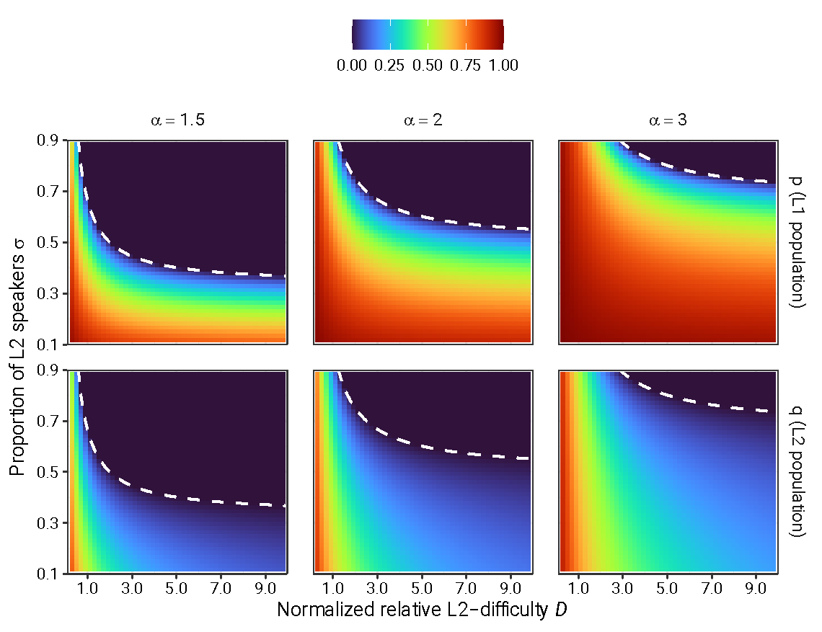
Modelling the dynamics
Trudgill (2011): “Simplification will occur … to the extent that untutored, especially short-term, adult second-language learning … not only occurs but dominates.”
What does “dominates” mean?
Heat maps from Kauhanen (2022) showing interaction of L2-difficulty and proportion of L2 speakers in population.
Simplification occurs when L2-difficulty (x-axis) and/or proportion of L2 speakers (y-axis) are high.
Bifurcation boundary can be found analytically for an infinite population; simulations show that finite populations behave in a similar way.
darker blue = more use of L2-simple option
darker red = more use of L2-complex option
(Talk by Kauhanen, Tue 16:15–16:45; paper to appear in Glossa)
Notes:
Simplification (region above the dashed white curve)

Slide 16
Outlook and conclusion
This paper lays out a programme for testing the Trudgill conjecture in the domain of syntax, and presents some preliminary results.
We have adopted the Interpretability Hypothesis as a characterization of L2-difficulty = complexity in syntax.
Work in the STARFISH project is ongoing to test our hypothesis in different domains.
Negation
Nominal concord
Null subjects
C/case
Our aim today: to convince you that a historical-corpus-based method is a useful complement to other ways of studying the Trudgill conjecture!

Slide 17
Thanks for
your attention!
George, Gemma, Raquel, Molly, Sarah & Henri
Department of Linguistics
University of Konstanz
https://www.ling.uni-konstanz.de/en/walkden/starfish/
https://twitter.com/KonstanzLing
We gratefully acknowledge funding from the European Research Council, grant no. 851423 (STARFISH)

Slide 18
References (1/2)
Berdicevskis, Aleksandrs, and Arturs Semenuks. 2022. Imperfect language learning reduces morphological overspecification: Experimental evidence. PLoS ONE 17 (1): e0262876.
Bini, Milena. 1993. La adquisición del italiano: Más allá de las propiedades sintácticas del parámetro pro-drop. In J. M. Liceras (Ed.), La lingüística y el análisis de los sistemas no nativos: 126–139. Dovehouse Editions Canada.
Breitbarth, Anne. 2014. The history of Low German negation. Oxford: OUP.
Caha, Pavel. 2009. The nanosyntax of case. PhD dissertation, University of Tromsø.
Sessarego, Sandro. 2013. Afro-Hispanic Contact Varieties as Conventionalized Advanced Second Languages. IBERIA 5 (1): 99–125.
Sinnemäki, Kaius. 2020. Linguistic system and sociolinguistic environment as competing factors in linguistic variation: A typological approach. Journal of Historical Sociolinguistics 6 (2): 1–39.

Slide 19
References (2/2)
Toribio, Almeida J. 2000. Setting parametric limits on dialectal variation in Spanish. Lingua: International Review of General Linguistics 110 (5): 315–341.
Trudgill, Peter. 2011. Sociolinguistic typology: social determinants of linguistic complexity. Oxford: Oxford University Press.
Tsimpli, Ianthi Maria and Dimitrakopoulou, Maria. 2007. The Interpretability Hypothesis: Evidence from wh-interrogatives in second language acquisition. Second Language Research 23. 215–242.
Tsimpli, Ianthi Maria and Lavidas, Nikolaos. 2019. Object Omission in Contact: Object Clitics and Definite Articles in the West Thracian Greek (Evros) Dialect. Journal of Language Contact 12: 141–190.

Slide 20
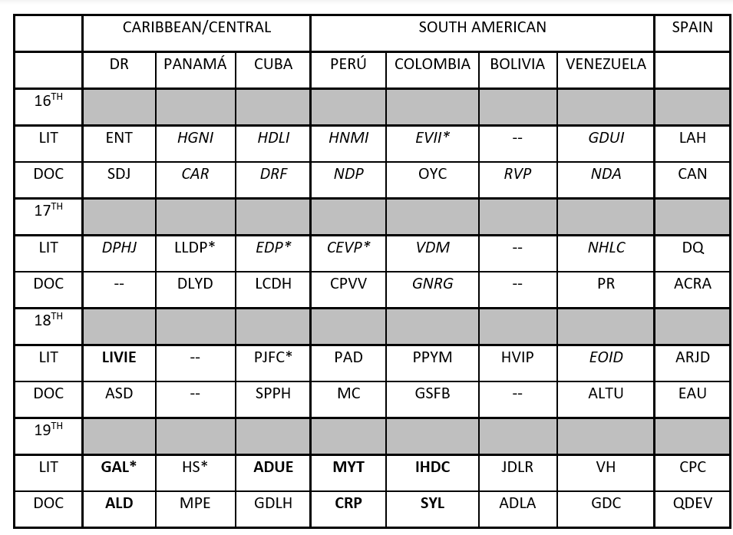
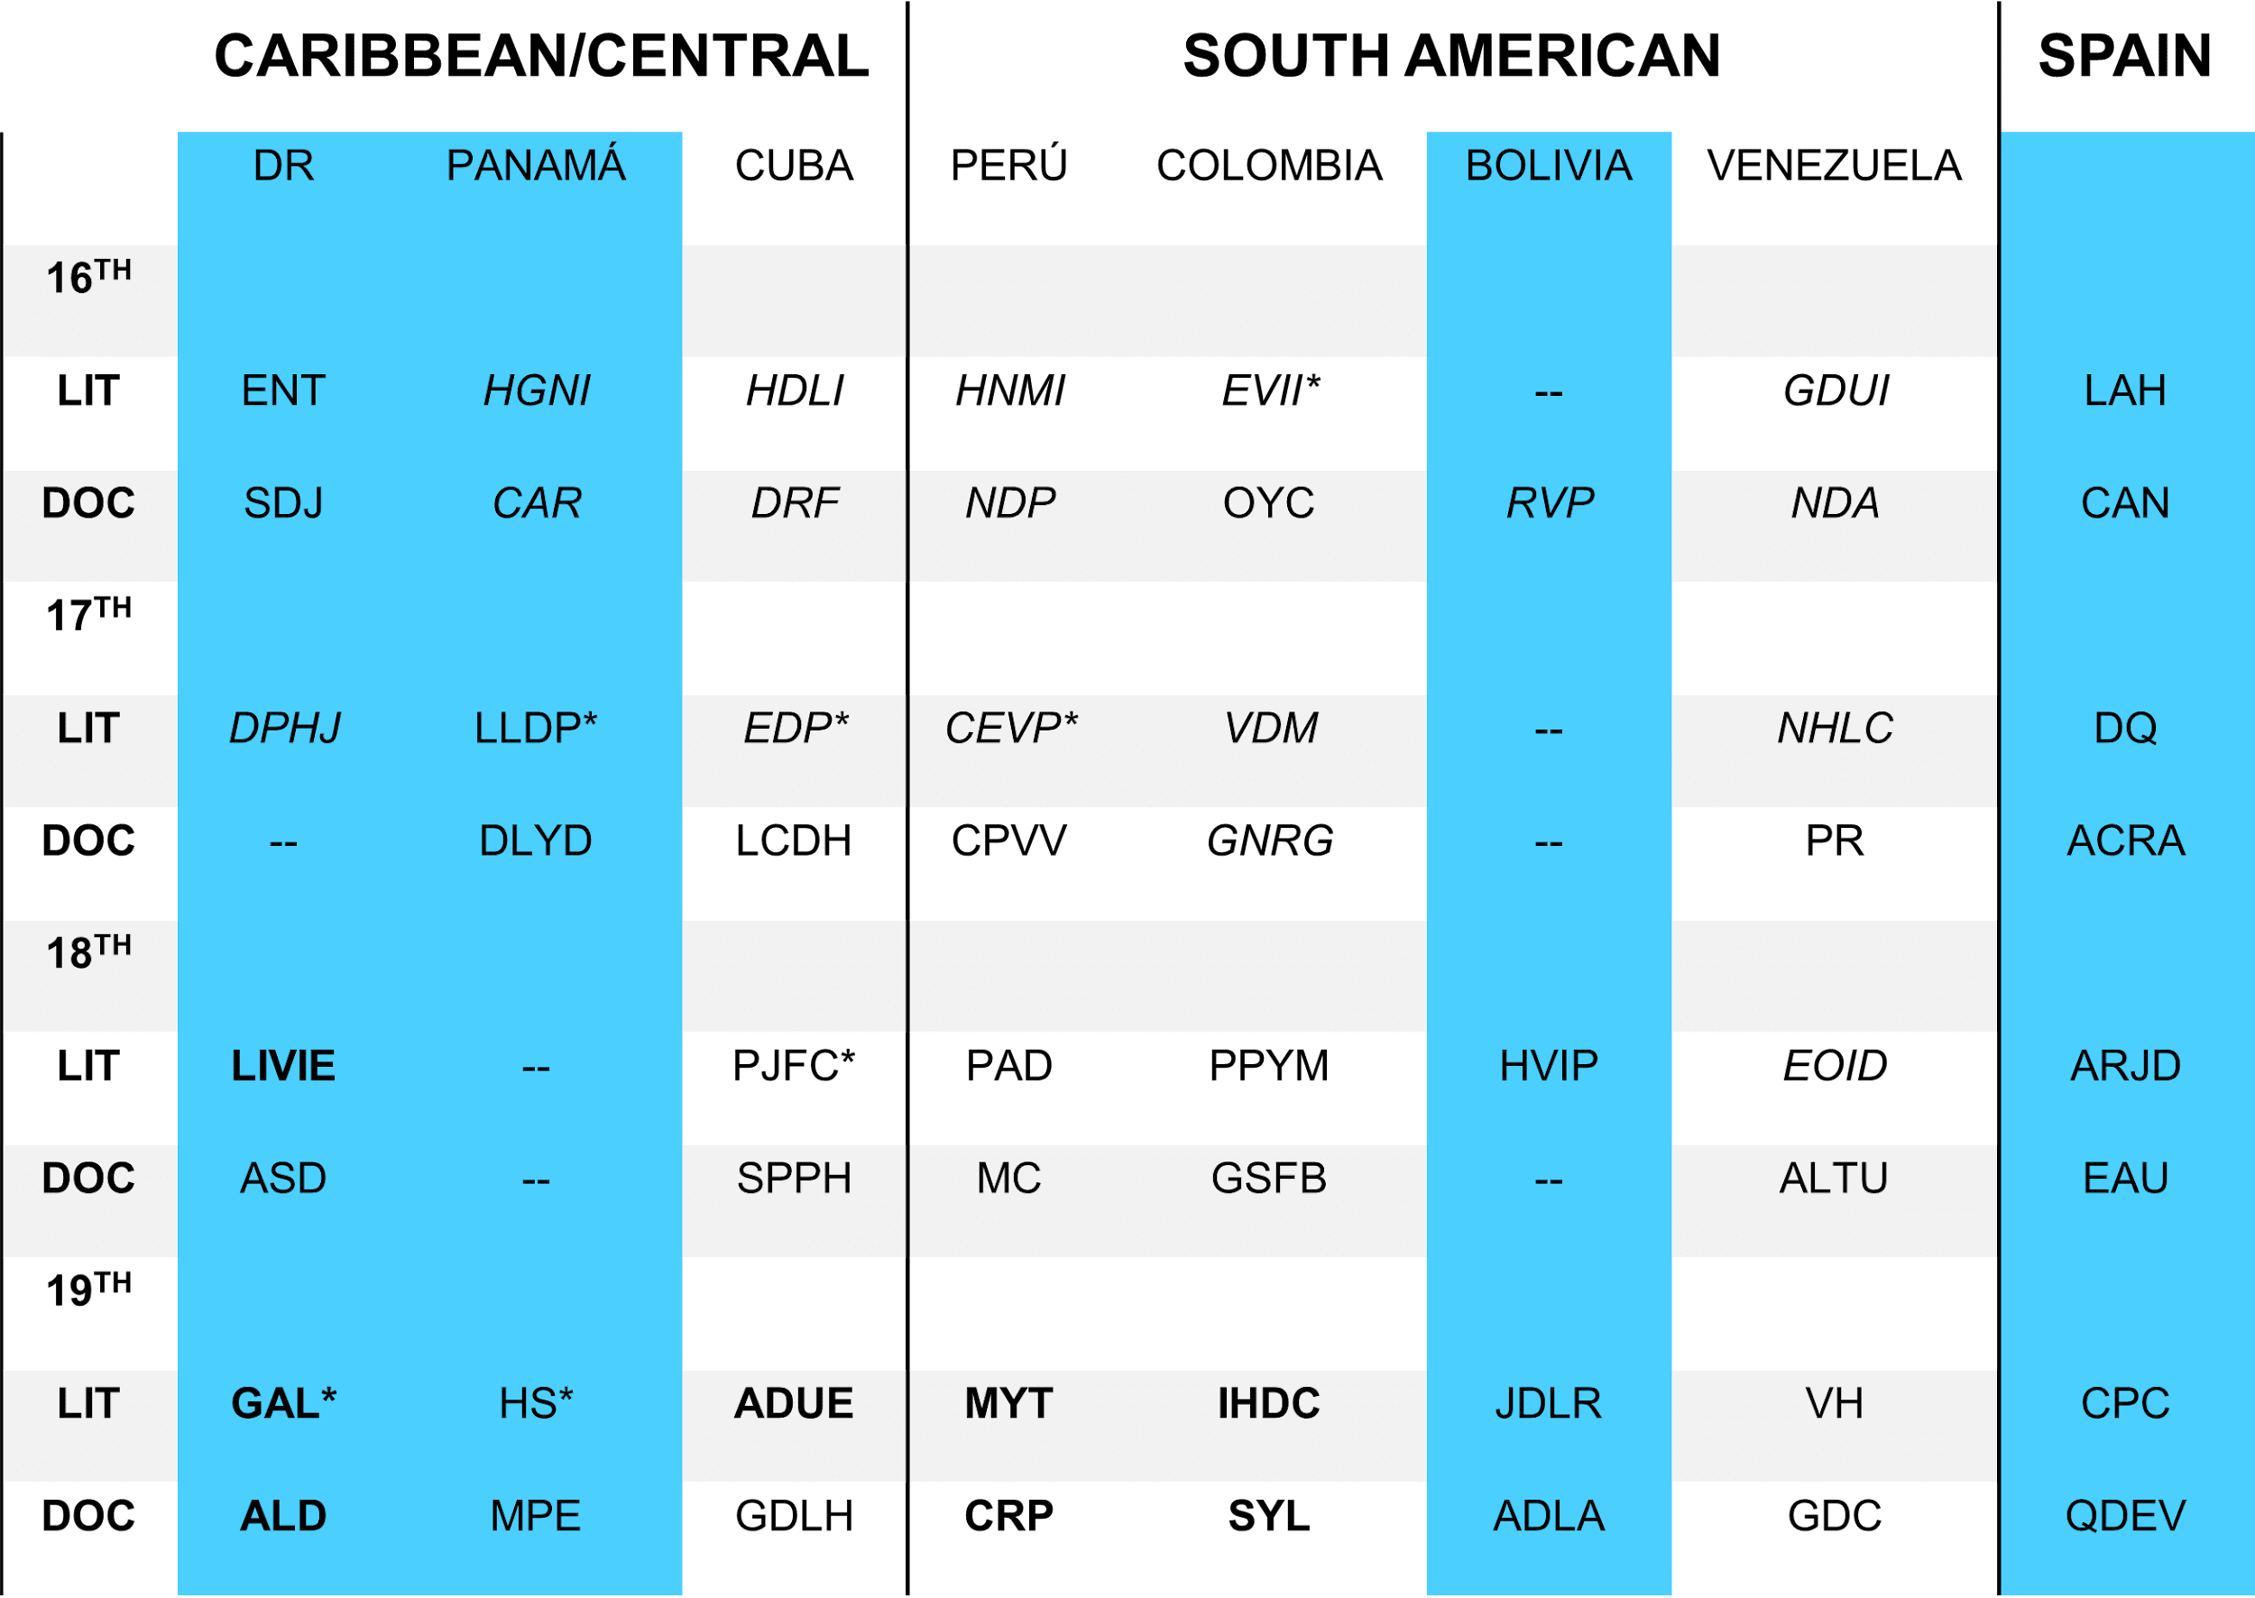
Extra slide: Spanish corpus
Corpus Status | AH | Born in Spain | Verse*
Corpus Composition | AH | Born in Spain | Verse*

Slide 21
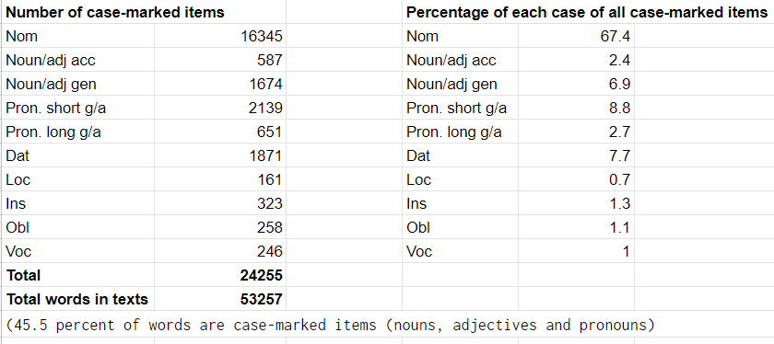
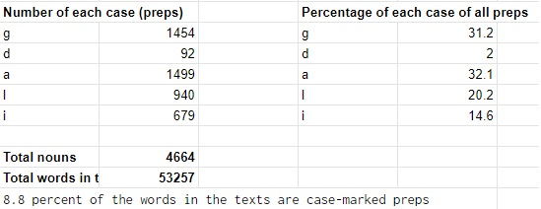
Extra slide: Balkan case data

